Slide 1
Software Engineering
Prepared by: Neha Tripathi

Slide 2
Rapid Application Development (RAD) Model

Slide 3
RAD Model
The Rapid Application Development Model was first proposed by IBM in 1980’s.
It is based on prototyping and iterative development with no specific planning involved.
Using the RAD model, software product is developed in a short period of time(60-90 days).
The critical feature of this model is the use of powerful development tools and techniques.
In RAD model the components or functions are developed in parallel as if they were mini projects. The developments are time boxed, delivered and then assembled into a working prototype.
This can quickly give the customer something to see and use and to provide feedback regarding the delivery and their requirements.
Rapid Application Development focuses on gathering customer requirements through workshops or focus groups, early testing of the prototypes by the customer using iterative concept, reuse of the existing prototypes (components), continuous integration and rapid delivery.

Slide 4
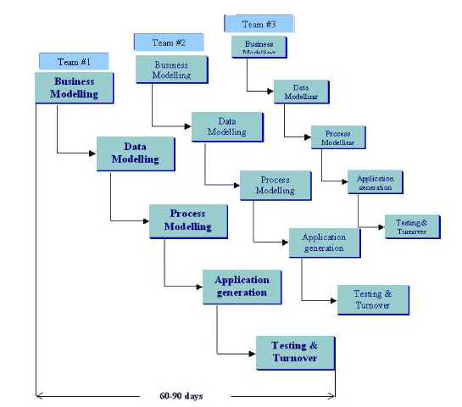
RAD Model representation

Slide 5
Phases of RAD Model
1.Business Modelling: The information flow among business functions is defined by answering questions like what data drives the business process, what data is generated, who generates it, where does the information go, who process it and so on.
2. Data Modelling: The data collected from business modeling is refined into a set of data objects (entities) that are needed to support the business. The attributes (character of each entity) are identified, and the relation between these data objects (entities) is defined.
3. Process Modelling: The information object defined in the data modeling phase are transformed to achieve the data flow necessary to implement a business function. Processing descriptions are created for adding, modifying, deleting, or retrieving a data object.
4. Application Generation: Automated tools are used to facilitate construction of the software; even they use the 4th GL techniques.
5. Testing & Turnover: Many of the programming components have already been tested since RAD emphasis reuse. This reduces the overall testing time. But the new part must be tested, and all interfaces must be fully exercised.

Slide 6
When to use RAD Model?
RAD should be used only when a system can be modularized to be delivered in an incremental manner.
It should be used if there is a high availability of designers for Modelling.
It should be used only if the budget permits use of automated code generating tools.
RAD SDLC model should be chosen only if domain experts are available with relevant business knowledge.
Should be used where the requirements change during the project and working prototypes are to be presented to customer in small iterations of 2-3 months.

Slide 7
Advantages of RAD Model
Reduced development time.
Increases reusability of components
Quick initial reviews occur
Encourages customer feedback
Integration from very beginning solves a lot of integration issues.

Slide 8
Disadvantages of RAD Model
Depends on strong team and individual performances for identifying business requirements.
Only system that can be modularized can be built using RAD
Requires highly skilled developers/designers.
High dependency on modeling skills.
For smaller projects, we cannot use the RAD model.
Inapplicable to cheaper projects as cost of modeling and automated code generation is very high.

Slide 9
RAD Model Vs Traditional SDLC
The traditional SDLC follows a rigid process models with high emphasis on requirement analysis and gathering before the coding starts. It puts pressure on the customer to sign off the requirements before the project starts and the customer doesn’t get the feel of the product as there is no working build available for a long time.
The customer may need some changes after he gets to see the software. However, the change process is quite rigid and it may not be feasible to incorporate major changes in the product in the traditional SDLC.
The RAD model focuses on iterative and incremental delivery of working models to the customer. This results in rapid delivery to the customer and customer involvement during the complete development cycle of product reducing the risk of non-conformance with the actual user requirements.

Slide 10
Thank You!

